Slide 1
Survival Modeling, Machine Learning Models, and Accessing TCGA Data
Jack Goodman
Some slides used from Germán Rodríguez Pop 509 course Princeton

Slide 2
What is Survival Data
Anything that is “time to event”
Can be death
Relapse
Action after intervention
Requires defined start and end points
Types of data
Right censored
Left truncated or “delayed entry”
Interval (can think of it as both)

Slide 3
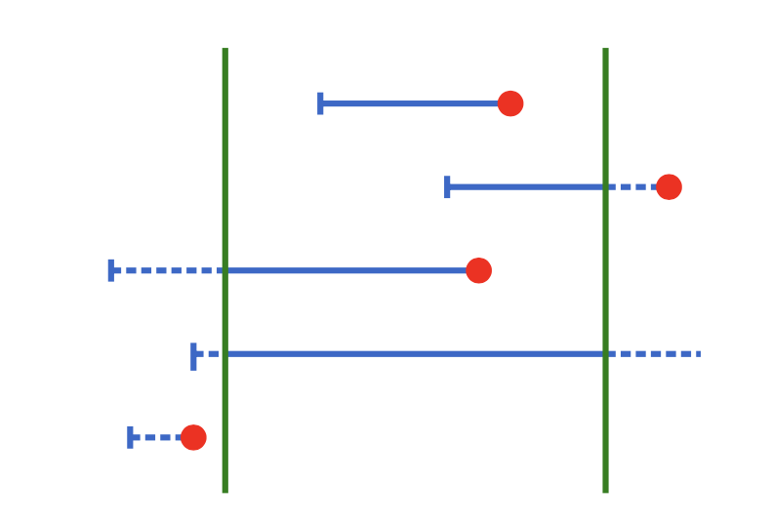
Right Censored
Survival Data
Known start
May or may not have a defined exit
This is fairly common
Same style as the cancer data we have

Slide 4
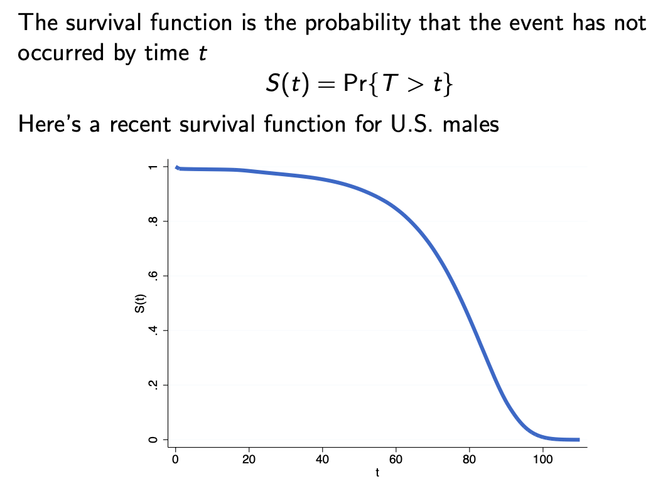
Survival Function
The survival curve is a stepwise function
How do we treat censored data?
They are dropped from consideration, but they do not count as events

Slide 5
Statistical Tests
Parametric
Makes assumptions
Non-parametric
Doesn’t make assumptions AKA not normal data

Slide 6
Survival Tests
Kaplan Meier
One variable at a time
Adjustment for multiple comparisons
Cox Proportional Hazards Model (Cox PH)
All variables at once
No adjustment

Slide 7
Side Note About Adjustments for Multiple Comp
P value is normally .05 but what does it mean?

Slide 8
Side Note About Adjustments for Multiple Comp
P value is normally .05 but what does it mean?
The chances of this result occurring by chance is 5%

Slide 9
Side Note About Adjustments for Multiple Comp
P value is normally .05 but what does it mean?
The chances of this result occurring by chance is 5%
So if you do 20 tests one after the other chances are that you will get 1 false positive
Many adjustment methods
False Discover Rate
Bonferroni correction (simplest and most stringent)
.05/# of tests you are doing

Slide 10
Cox PH
Even though you compare multiple variable you do not need adjustment
Semi-parametric model and simple to test the assumptions
Can struggle when dealing with many variables
I don’t have a hard cut off here but 15+ you might want to get suspicious
Many adaptions
Lasso, net, and random forest
Essentially iteratively select variables and keep ones that are significant
Deep learning methods are best but require 10’s of thousands of samples

Slide 11
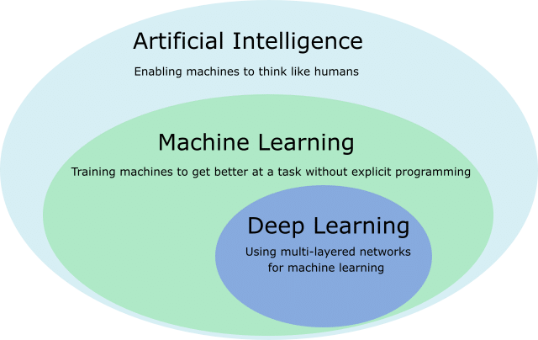
Machine Learning Methods
Machine learning
A method that allows for the computer to improve without further input
Variable selection, coefficient variation
Ex: Lasso method
Deep learning
The method improves itself by seeing patterns and combinations of variables
Ex: Neural networks
Requires a MASSIVE dataset
https://7wdata.be/big-data/ai-vs-machine-learning-vs-deep-learning/

Slide 12
Glmnet – R Package
The package we use for all our regressions
Fits a generalized linear model with some form of Lasso
Fits
Linear
Logistic
Multinomial
Poisson
Cox Regression

Slide 13
What is Lasso?
A method of variable selection and regularization
Regularization = Preventing overfitting
Machine learning

Slide 14
Inputs
Variables, all must be defined
Outcome, all must have a known outcome
Type of regression
Multinomial, survival, binomial, gaussian

Slide 15
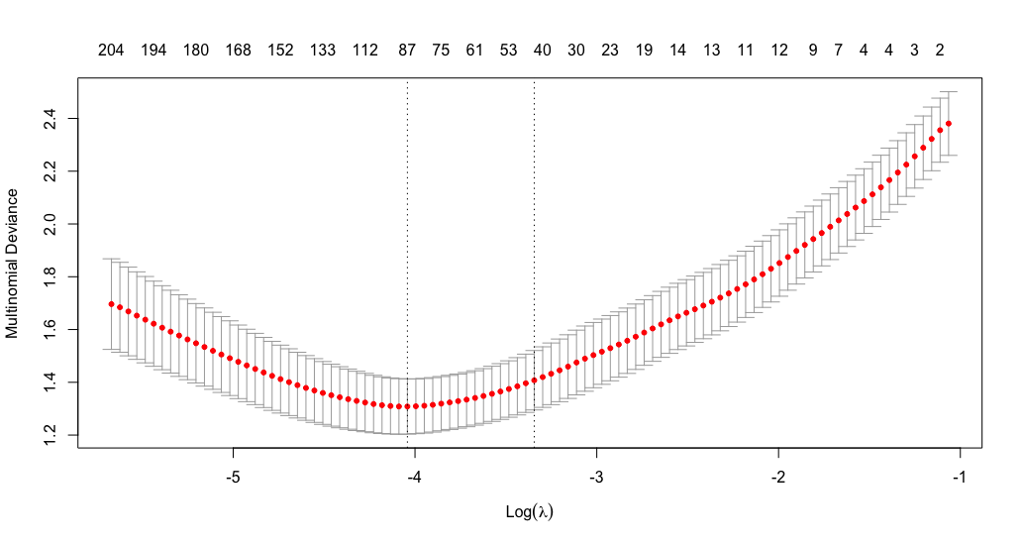
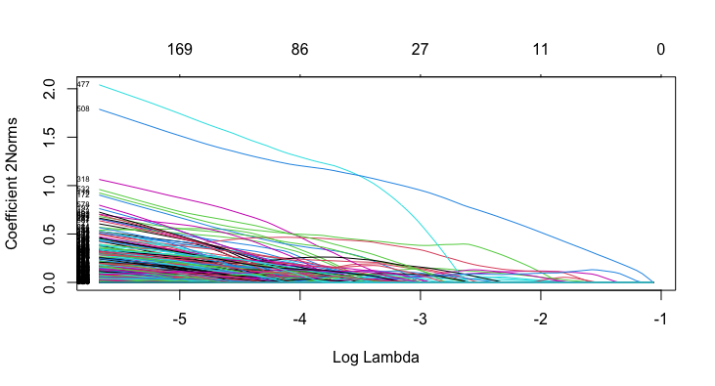
Outputs
Below: Absolute value of the coefficients for each variable as lambda varies
Above: A measure of goodness of fit, for multinomials you want the lowest.

Slide 16
Accessing TCGA
The Cancer Genome Atlas
~11,000 patients
Sequencing, RNA-seq, clinical, and other data
https://portal.gdc.cancer.gov/

Slide 17
TCGA Biolinks
Package from Bioconductor
All RNA has been re-normalized to
https://bioconductor.org/packages/release/bioc/html/TCGAbiolinks.html
Always download the harmonized dataset
Uses hg38 and RNA-seq is in FKPM
https://gdc.cancer.gov/about-data/gdc-data-processing/genomic-data-processing#ReferenceAlignment

